Slide 1
S-100 Validation Tests sub group
14th VTC Meeting
11th March 2026

Slide 2
Meeting protocol
Meeting participants are kindly requested to note the following meeting protocols;
Please keep your camera and microphone turned “off” if you are not talking or presenting
If you want to make an intervention, please turn your camera and microphone on and, raise your hand to indicate that you wish to speak
Don’t forget to turn your microphone “on” before speaking, and “off” when finished
Please use the “Chat” function to communicate an text information to the meeting
If you have any problems connecting using Firefox or other browser – please try using Chrome.

Slide 3
AGENDA
Update from S100 WG10
S-98 changes & Data Constraints document
Changes to other validation standards
Versioning issues
Work plan for Edition 2.0.0
Outstanding issues and topics
Next meeting

Slide 4
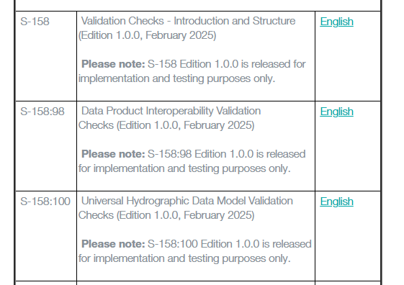
S100 validation sub group standards

Slide 5
Update from S-100 WG10
Working group presentation
Asked for approval to produce a revision to amend the criticality of the S-158:98 ‘holes’ error
New issues raised that have been added to the GitHub
Discussed the longer term plans for S-158:100 & 98 storage

Slide 6
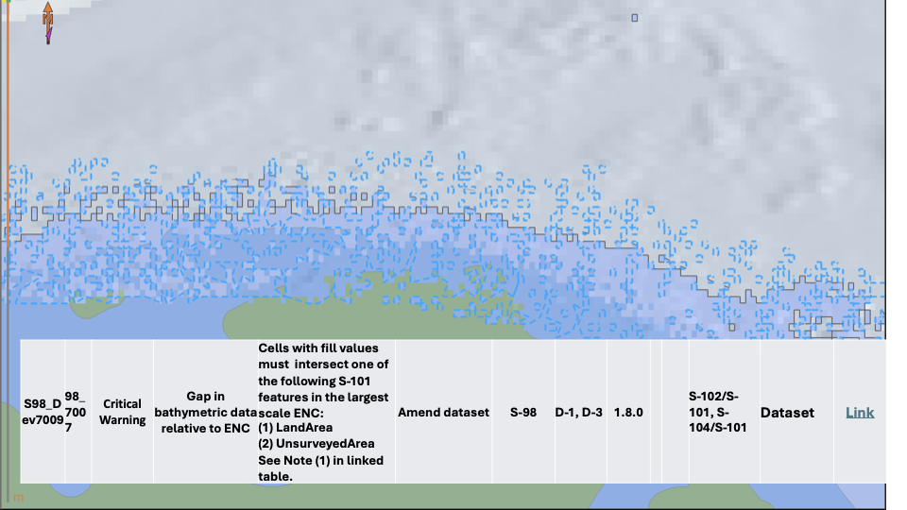
Update from S-100 WG10 - HOles
There was a last minute change to S-158:98 prior to HSSC
The check related to gaps in bathymetric data relative to the ENC and it has been difficult to reach consensus across WG/PTs
S-158:98 check S98_7007 has been upgraded from an Error to a Critical
At TSM it was clarified that the PT that owns the validation checks sets the criticality
This was agreed unanimously by the S-98 group and explained at HSSC and the validation sub group were informed
Request that that S-100WG approve the publication of S-158:98 1.1.0 to include the already agreed change to Critical
[Decision 10/36] WG10 agreed to leave the S-158:98 check S98_7007 classified as an error in this edition and tasked the S-102PT to discuss and develop a validation check for holes in S-158:102, determining whether it should be classified as an error or critical, taking OEM feedback into account.

Slide 7
Future validation checks storage
Continue in Excel and Word
Capture the validation checks in Metanorma
Create an S-100 Validation Checks Register on the IHO Registry page (UI over database)
Create a relational database
Decision 10/37] WG10 supported Option 3 (GI Registry) as the way forward and agreed to establish a task group to progress the work, while continuing to use spreadsheets during the development phase.
[Action 10/27] Task Group with contributions from S-100ValSG, IHO Sec, 7Cs, KHOA, NOAA (lead), BSH and NIWG to develop a database structure and define the management of the Validation Database in the GI Registry, including its interface
Not started – will be discussed at TSM12 to discuss whether we can put a request in for funds

Slide 8
Edition 2.0.0 or 1.1.0?
Goal from S-100WG 10 is to aim for Edition 2.0.0 for HSSC 19 (2027)
Draft for S-100WG 11 (October) and approve via circular letter early 2027
User impact study will be required
There has not been much feedback as checks have not been widely implemented
Discussion about whether to aim for 1.1.0 for HSSC 19 and follow and 2.0.0 for HSSC 20 (2028)
S-158:101 is producing:
1.1.0 for approval at S-100WG 11 (October 2026)
Edition 2.0.0 aligned with S-158:100 ed 2.0.0 for HSSC 19 (2027)
AHO have concerns about S-158:101 not being at edition 2.0.0, when S-101 data is being released. However, there is no type approved ECDIS yet.
Once go to edition 2.0.0 we have to get full member state approval
Will be discussed at TSM next week. What are the groups views?

Slide 9
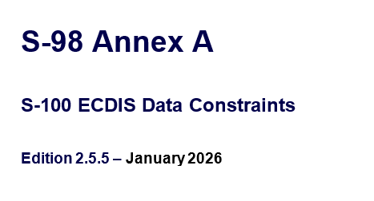
S-98 & Data constraints section
Draft version of S-98 edition is circulating
Comments will be discussed at TSM next week & VTC tomorrow
Will need to review for new validation checks for S-158:98
New Data Constraints section Annex A
Not removed from S-98 main document at this point
Expands on selected content related to data producers
Mandatory requirements for data
Provides ability to add validation check reference

Slide 10
Changes to other validation standards
S-58 Edition 9.0.0
Need to review if there are any impacts to S-158:100 & S-158:98
Unlikely, will mostly affect S-158:101 but they were revewing critical checks
S-158:101 Edition 1.1.0 submitted to S-100 WG11
Intention is to submit to HSSC 19 (2027) with Edition 2.0.0
All Phase 2 PS will submit S-158:1xx validation checks to HSSC when
Need to check S-129 plans but have received an email from Jason Rhee

Slide 11
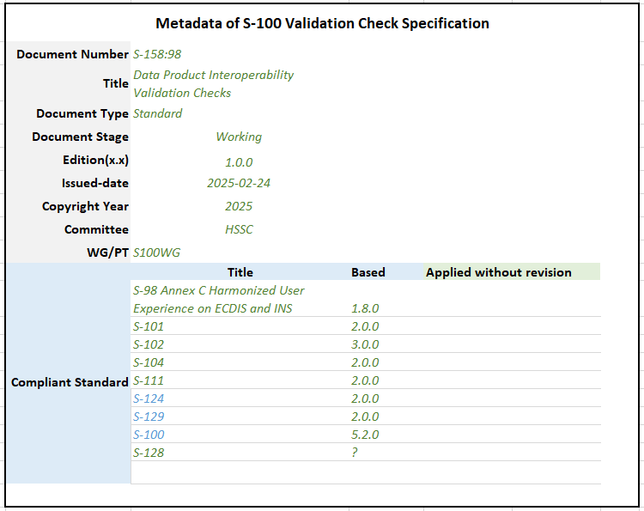
Versioning issues
How handle adding and removing validation checks without a new PS
Do the PS and validation checks need to be in alignment with edition numbers - no
Suggest holding a VTC with PS/S-158:1xx holders to review process and improvements

Slide 12
Work plan for Edition 2.0.0
 | Edition 2.0.0
1.1 | Kick off using funds for edition 2.0.0 & project outline
1.2 | Initiate work
1.3 | Review GitHub issues for inclusion
1.4 | Review S-98 for Edition 2.0.0
1.5 | Review S-58 for potential changes, primarily classifications
1.6 | Coordinate with S-158:1xx regarding versioning concerns
1.7 | Circulation in sub group
1.8 | Approval to S-100 WG
1.9 | Potential approval from S-100 WG via circular letter
1.10 | User impact study

Slide 13
Outstanding issues and topics
50 issues in GitHub
iho-ohi/S-100-Validation-Checks: S-100 Github repository for Validation Check development.

Slide 14
Next meetings
TSM 12, Monaco – 17-20th March
S-100 WG 11, New Zealand – 21-25th September
Next VTC meeting?
6-8 weeks - 27th or 28th April
(Assembly 20-23 April, Liz travelling Baltic Sea e-Nav 13-16th )

Slide 15
Any Questions?

